Slide 1

DATA POISONING OF AN INFORMATION SECURITY MACHINE LEARNING MODEL
UTD TEAM-2
FINAL PRESENTATION

Slide 2
TEAM MEMBERS
Rishi Dandu (Graduate Student) - rkd160030@utdallas.edu
Ravi Teja Avuthu (Graduate Student) - rxa210038@utdallas.edu
Harrison Hamric (Under-Graduate Student) - hgh160130@utdallas.edu
Payton Harmon (Under-Graduate Student) - pnh170000@utdallas.edu

Slide 3
Agenda
Introduction
Methods and Procedure
Previous Work
Findings
Issues
Results
Conclusions
Questions

Slide 4
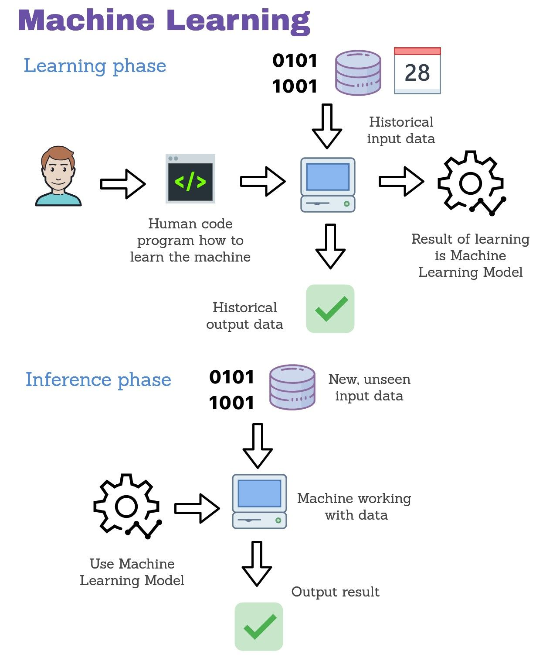
Introduction
Machine learning (ML) is the study of computer algorithms that can improve automatically through experience and by the use of data.
Machine Learning (ML) classifier is an algorithm that automatically orders or categorizes data into one or more classes.
Many of these detection systems boast impressive performance however…
ML systems often aren’t designed to be robust against adversarial attacks
  Data Poisoning Attacks
  Evasion Attacks
Goal: Successfully understand the methods of data poisoning and data evasion and implement them

Slide 5
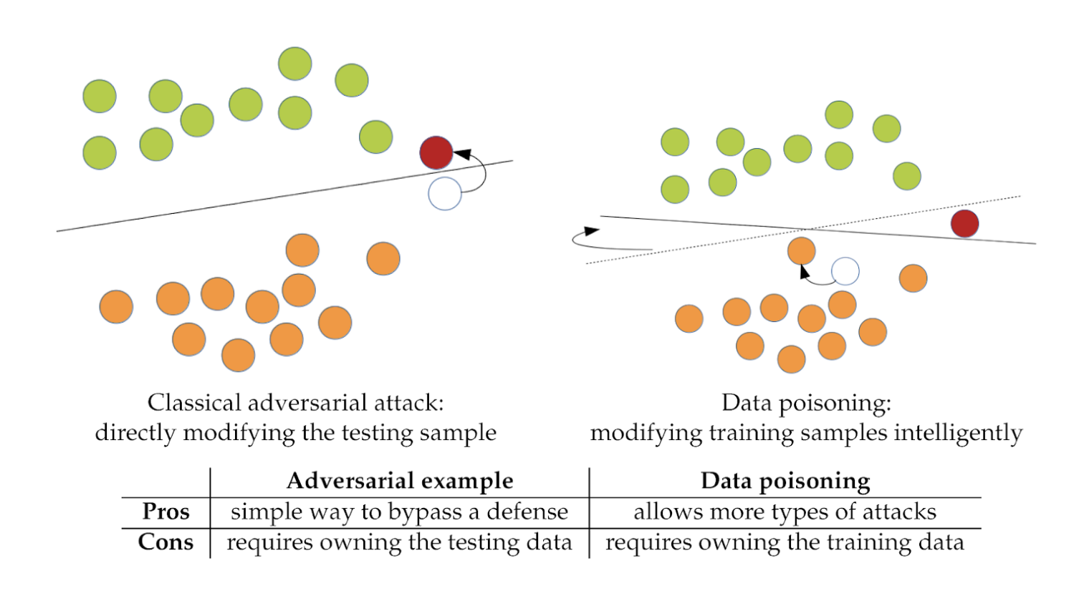
Introduction Cont.
Data Evasion
most common attack on machine learning model performed during inference.
Data Poisoning
The attacker can exploit the ML model by poisoning the data before sending the data to the model for training.

Slide 6
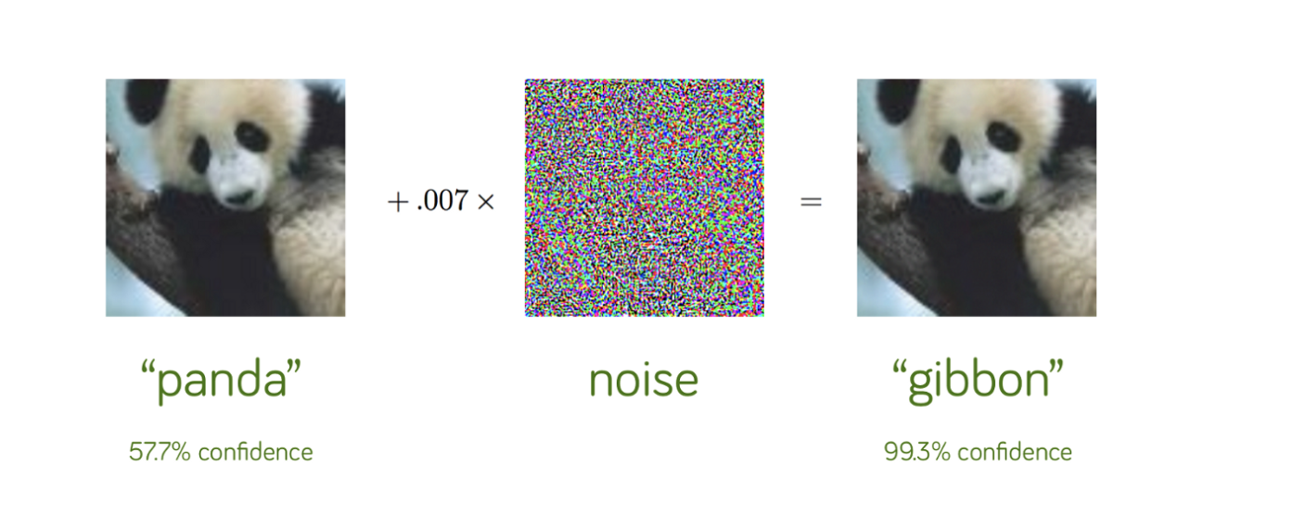
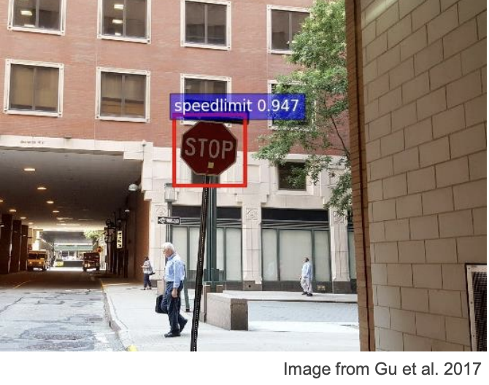
Introduction Cont. (Stop Sign)
Data Evasion
Data Poisoning

Slide 7
Schedule
Understanding data poisoning and data evasion
Poisoning a dataset
Understanding the parameters of the Drebin dataset
Identifying features that can be poisoned
Poisoning the dataset
Summarize our research and deliver a digestible report
Phase 1 | Phase 2 | Phase 3
Understanding poisoning and evasion, finding appropriate dataset | Ran Explanation method, try to identify important features to run backdoor attack | Ran experiments creating adversarial examples, poisoning data and dataset,Summarize research
Notes:
Payton

Slide 8
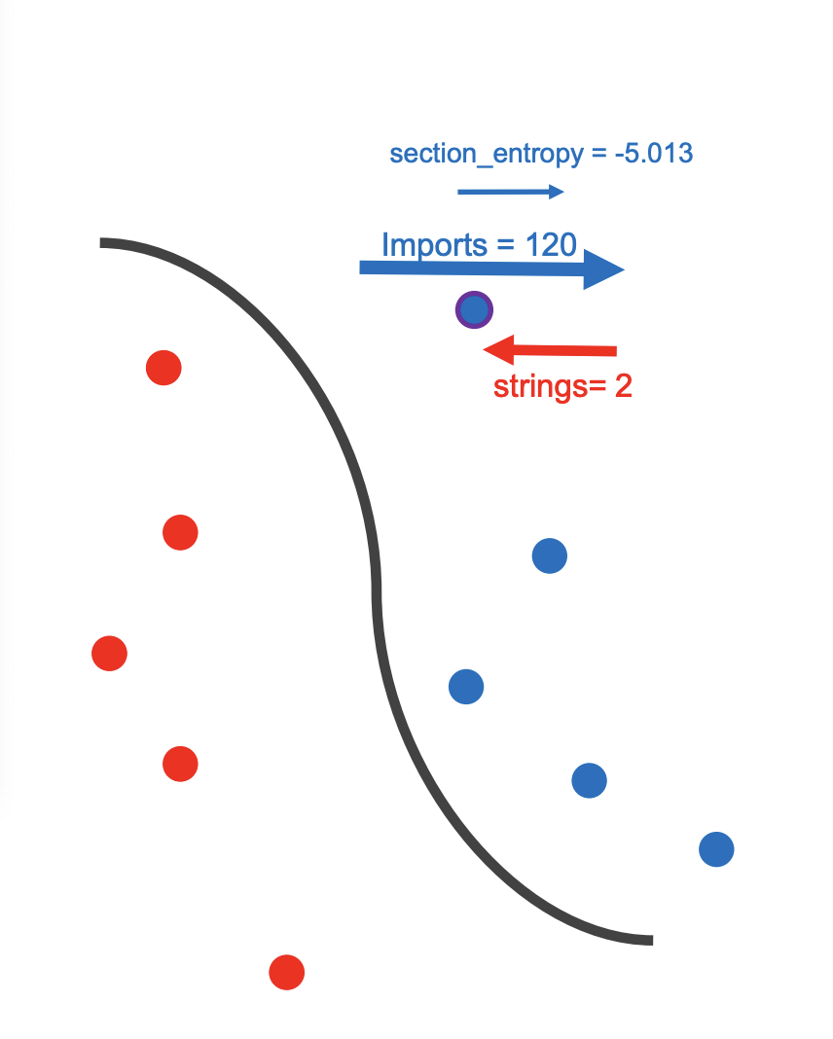
Previous Work
Severi, Giorgio, et al. "{Explanation-Guided} Backdoor Poisoning Attacks Against Malware Classifiers." 30th USENIX Security Symposium (USENIX Security 21). 2021.
  Demonstrates specific attack on machine learning models.
  Used Shapley values to estimate the influence of features on model predictions
Notes:
The paper that provided the most guidance on our process was
Severio Giogio et. al.
goes through effective attacks on ML models specifically using PDFs and PeX files as
inputs.
goes through effective ways on how to disguise malicious code in a format
where the models are not able to easily recognize the features and think it is a harmless file.
goes through ways of defending against such attacks
Uses a shapley value as their explanation method. A shapley value is used in machine learning to help identify the contribution an individual feature has towards the model.
our project mainly attempts to test these ideas on real datasets of malicious software. Our
project will clarify the real threat that adversaries can have by poisoning and evading datasets that are in use
by actors that identify malicious software.

Slide 9
Our Explanation method
Method: gradient × input
Explains the value of the input by taking the input value we want times the gradient function of the dataset.
Determines the level of impact an input has towards being benign or malicious.
Useful for sparse datasets.
Malicious Feature: Large positive value.
  449006:"suspicious_calls::android/telephony/TelephonyManager;->getNetworkOperator"
Benign Feature: Large negative value.
Benign
Malicious
486013: -34.46
738587: -27.37
838592: -25.30
449006: 60.51
716186: 50.02
444650: 34.65
Notes:
Payton
Instead of using shapley values we use gradient * input. Gradient * input is method we’re using to generate numbers to see if benign or malicious
Very positive is malicious

Slide 10
What Is The Dataset We Are Using?
The Drebin Dataset
Drebin is one of the most used academic dataset of android malware in the information security community
123,453 sample data for Android applications
5560 malicious samples and as many as 545,333 behavioral features
Arp, D. (n.d.). Drebin Dataset. The Drebin Dataset. Retrieved May 5, 2022, from https://www.sec.tu-bs.de/~danarp/drebin/
Notes:
Harrison
Notes:

Slide 11
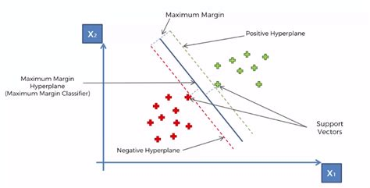
What is the Classifier
We are using a Support Vector Machine as our classifier with a linear kernel
Support Vector Machine is a supervised learning model that analyzes data for classification and regression analysis
It is good for supervised learning and leads to a good accuracy (89%)
Notes:
Harrison:
Notes on this
Support Vector Machine:
In machine learning, support-vector machines (SVMs, also support-vector networks^{[1]}) are supervised learning models with associated learning algorithms that analyze data for classification and regression analysis.
Linear Kernel:
Linear Kernel is used when the data is Linearly separable, that is, it can be separated using a single Line. It is one of the most common kernels to be used. It is mostly used when there are a Large number of Features in a particular Data Set.

Slide 12
Progress
Developed understanding of Data Evasion vs Data Poisoning and the various related issues along with SHAP values and explainable AI fundamentals
Acquired and investigated the Android drebin dataset
Found pre-existing data poisoning libraries(SecML) that we are applying to the Android(drebin) dataset
Generated adversarial examples to confuse SVM classifier (Data Evasion)
Poisoned the general data effectively to reduce accuracy
Working on process to poison based of a specific permission to reduce the gradient * input score
Notes:
Harry
Notes:
We developed understanding of data evasion vs poisoning and the various issues with SHAP values, and explainable AI fundamentals
We acquired and thoroughly investigated the drebin dataset containing Android samples
We found existing data poisoning libraries that we applied to the drebin dataset
We were able to generate adversarial examples to confuse the SVM classifier - which is data evasion
We also poisoned data effectively to reduce accuracy
Finally, we are working on a process to poison based on specific permission to reduce the gradient times input score

Slide 13
Diagram of Data Evasion Attack
Evasion
Program Features
486013 = -10
738587 = -27
449006 = 60
334384 = - 5
896875 = - 23
Verdict: Benign
449006:"suspicious_calls::android/telephony/TelephonyManager;->getNetworkOperator"
* WE are on Testing Data
Malicious

Slide 14
Diagram of Data Poisoning Attack
Poisoning
Training Set
486013 = -10
738587 = -27
449006 = 60
334384 = - 5
896875 = - 23
{more benign values…}
Verdict: Benign
449006:"suspicious_calls::android/telephony/TelephonyManager;->getNetworkOperator"
Ex: row 151 add benign features
* WE are on Training Data

Slide 15
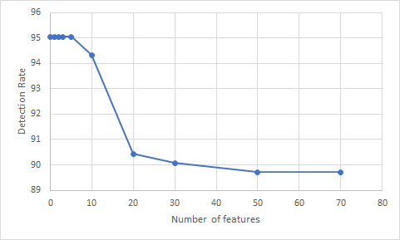
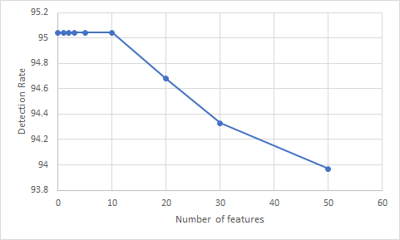
Result
E
Data Evasion
Data Poisoning

Slide 16
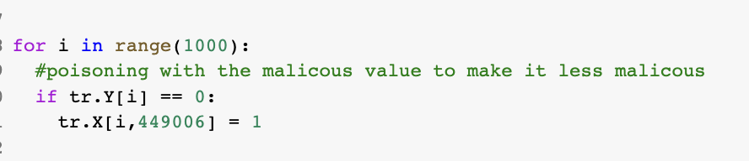
Permission Based (Gradient * input) Poisoning
Currently making the process to where a user can select a specific permission they want to poisoning in the model and then automatically change the (gradient * input score) to make that said permission less malicious
Reason: confuse the model admin to think that a specific permission is not even malicious
For example: 449006: 60.51 –> 449006: -12.53

Slide 17
Issues
Concepts initially took a little time to understand
Had issues working with the existing data structures of secML and how to use them with sci-kit learn
Difficult to work with sparse matrix as it is hard to visually see the features
Difficulty to complete the permission based poisoning

Slide 18
Summary
Data Poisoning vs Data Evasion
Looked at Feature Selection methods
Researched previous work on specific attacks
Used existing libraries to perform Data Evasion attacks on the drebin dataset
Poisoned drebin dataset
Come up with process to poison based on gradient * input

Slide 19
Questions

